Slide 1
WELCOME TO CLASS 2
Notes:
What does this mean? Discuss

Slide 2
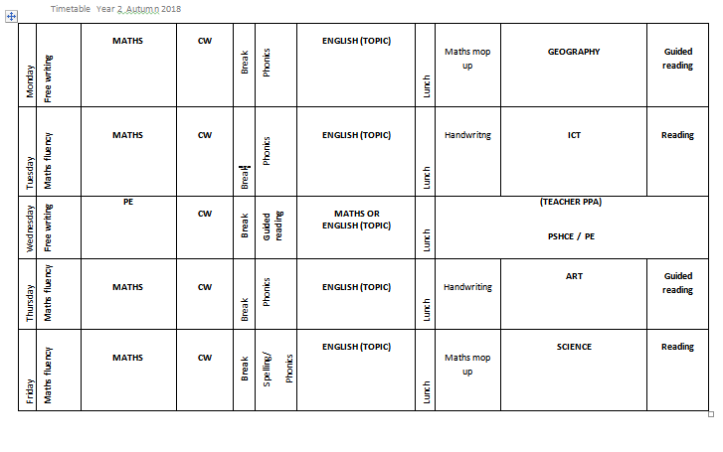
TIMETABLE

Slide 3
Homework
Reading – every day, AND TALKING ABOUT WHAT YOU HAVE READ
Maths skills – primarily counting based (more details to follow)
Notes:
Let the children talk about this in their trios and then explain that we will return to it later in the week.

Slide 4
Feedback in books
Green highlighter – something that’s gone well
Pink highlighter – something that needs to be checked
VF – Verbal feedback from adult
- Next Steps
Notes:
How can you count the owls? Do you have a strategy? Which is the largest number? Which numbers sound similar ?

Slide 5
THE BLOG
Our Class 2 blog will go onto the school website on Friday evenings. Please read it to find out what the children have been doing in school that week. We will also use the blog for any homework activities an links to activities that you may wish to do to support learning at home.

Slide 6
Purple Paddy and Bob the bear
Purple Paddy – Will be coming home throughout the year to learn something new at home from your child.
Bob the Bear – Will be coming home on Fridays for your child to share a book with.
Notes:
How can you count the owls? Do you have a strategy? Which is the largest number? Which numbers sound similar ?

Slide 7
Twitter
If you haven’t already done so, please sign up to Twitter and search for @CrowmarshSchool to get lots of pictures and updates about daily life in school.

Slide 8
DATES
Parents’ Evening will be taking place on the week of the 15th of October. Various time slots will be available. Please don’t hesitate to let us know if you have any questions or concerns before that point.
Open afternoons will be on the last week of each small term. Look out for the dates.

