Slide 1
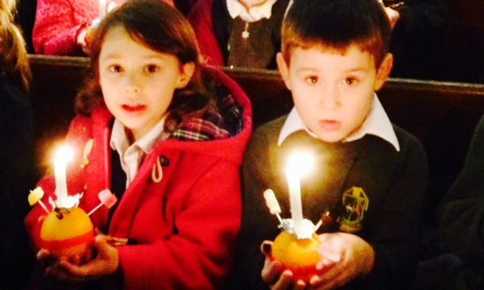
This Is Our School:
Crowmarsh Gifford CE Primary

Slide 2
Agenda
Introduction
Progress in the Last Year
School Development Plan
Growth-Mindset
Digital Leaders Presentation
Teachers’ Curriculum Presentation
A Brief Overview of IT
Governor Involvement in School
PTA Presentation
Q&A with Sub-Committee Representatives

Slide 3
This Past Year...
What have we achieved?

Slide 4
Some of our Milestones….
Top 20 schools in Oxfordshire (League Tables) based on KS2 end of Year 6 data
Outstanding judgement overall in SIAMS
100% phonics success in year 1
Foundation International Schools Award
SSAT Children’s Attainment Award

Slide 5
Curriculum Achievements
Successfully rolled out new exciting and engaging curriculum
Peer to peer coaching
Tailored training to ensure ‘outstanding’ practice
Budgetary and financial support to provide resourcing across the school
Established a breakfast and after school club
Increased parent understanding of key areas
Leading the network in key areas

Slide 6
Pupil Progress and Success….
Challenging every child to develop a growth mind-set
Preparing children for success in modern Britain
A focus on ‘individual’ children and their ‘individual’ needs
Open classrooms every small term, more opportunities to learn about what the children do in school
More opportunities for pupil leadership (House Leaders, Sport’s Leaders, Librarians, Worship Team, Digital Leaders, etc.)
Christmas performances – every child had a part to play
Wide variety of extracurricular activities throughout the day to spark children’s interest

Slide 7
School Development Plan
Last Year’s Successes
Safeguarding– new safeguarding induction/training for staff/visitors
Outstanding progress
SIAMS
Guided Reading
Timetabling of learning groups – Break out groups
Handwriting
New curriculum written and rolled out across the school
Community

Slide 8
New server, network and wireless system installed
Learning spaces developed
Reinforcement of good behaviour/manners and respect
House system
Health and safety excellence
Website (Twitter, Blogs, Class Pages, Texts)
Prospectus, handbook
Transition into reception class
Communication
Distributed leadership “Every teacher is a ‘leader’ of learning”
New Teaching for Learning and Marking policies implemented
Established breakfast/after-school club
International school work
Partnership Work – Wallingford Partnership, Oxfordshire Teaching School’s Partnership (OTSA) and SSAT (School’s Network – National)

Slide 9
SDP This Year
Key Highlights
Raising pupil’s achievement (focusing on groups of pupils)
Focusing on questioning in all lessons
Involving parents more in their child’s learning
Raising profile of reading and ‘talk’
Embedding climate of challenge and growth mind-set
To further embed transition into reception
Distributing leadership within staff and pupils
Enhancing links with the community
Developing outdoor space
Key updates – EYFS (Ofsted)

Slide 10
Our Learning Journey…..
Working with Di Pardoe – again leading this with our partnership schools
Based on research by Carol Dweck about ‘mindset’
Research shows how teaching these skills helps raise children’s achievement across the board.
It is about ensuring ‘every’ child reaches their full potential

Slide 11
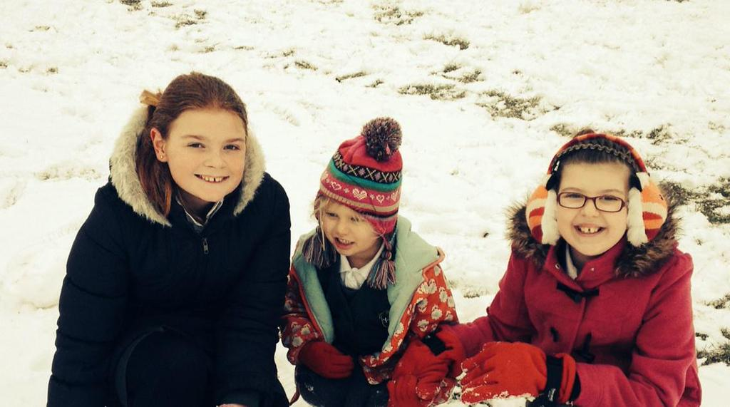
What do we mean by successful citizens?
Successful learners who enjoy learning, make progress and achieve
Confident individuals who are able to live safe, healthy and fulfilling lives
Responsible citizens who make positive contributions to society
© Di Pardoe Training and Consultancy 2014

Slide 12
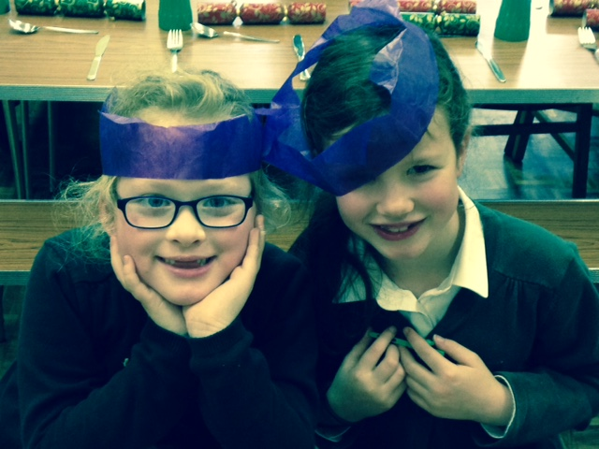
What does it mean to be ready to learn?
What do we mean by learning success?
What do successful learners do?
What is real achievement?
How can we best promote and support learning at home?
© Di Pardoe Training and Consultancy 2014

Slide 13
Striving for a future where our children:
have the opportunities to be the best they can be
are confident and motivated and embrace challenge
persevere and are resilient in the face of difficulties
use critical and creative thinking to solve problems
work collaboratively and independently
take responsibility for themselves and their learning
© Di Pardoe Training and Consultancy 2014

Slide 14
How do you feel when you are learning?

Slide 15
Danger zone
Learning is a bit tricky
Challenge zone
Comfort zone
Learning is easy
Learning is too hard
© Di Pardoe Training and Consultancy 2014

Slide 16
“Dweck's research falls into the category of most of the best of our research into education, in that it merely ends up confirming the eternal truths of the classroom: turn up, work hard, study, do well; work harder, do better; believe you can improve and you probably will, believe that you can't and see what happens.”
Tom Bennett

Slide 17
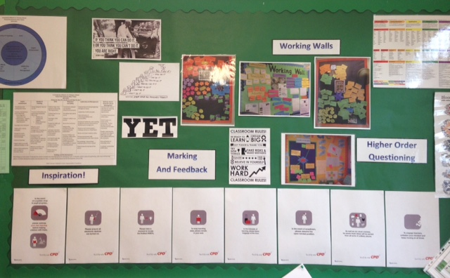
The power of
YET.....

Slide 18
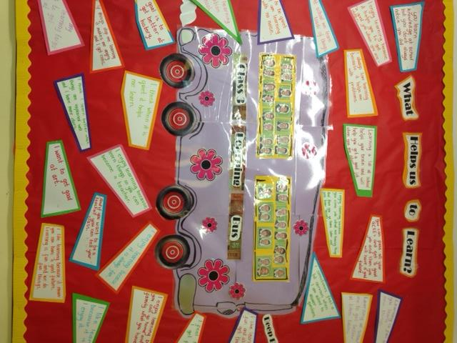
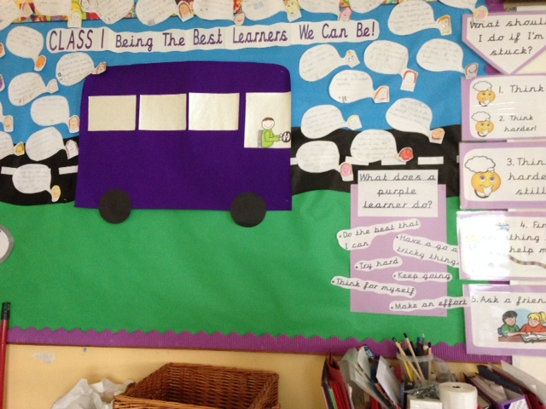
What does a
‘purple learner’ do?
© Di Pardoe Training and Consultancy 2014

Slide 19
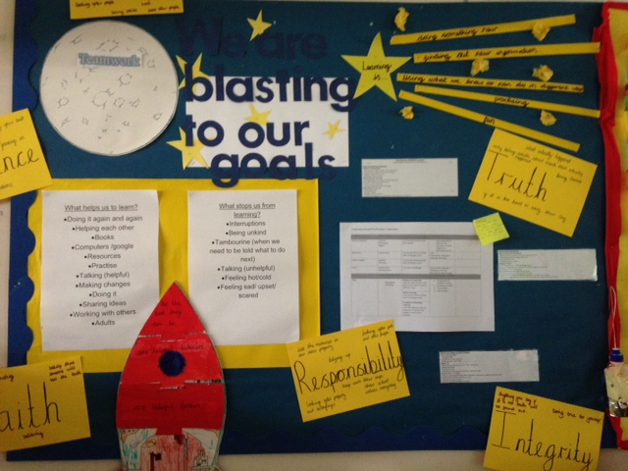
I will be a purple learner when I...
tackle problems positively
persevere when things get difficult
think for myself before asking for support
stay determined
aim high
© Di Pardoe Training and Consultancy 2014

Slide 20

...the best learning experiences lie within the extended grasp...
© Di Pardoe Training and Consultancy 2014

Slide 21
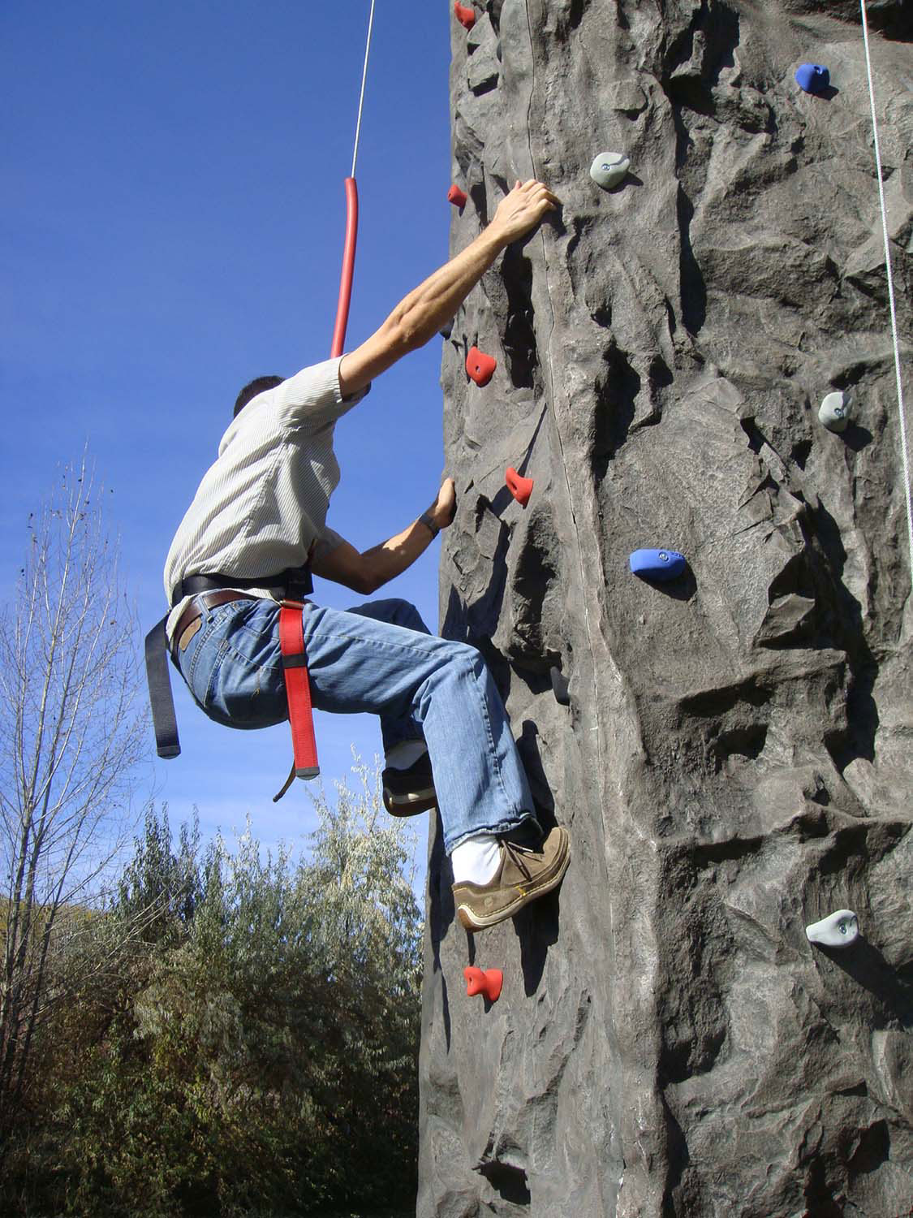
What is
challenge?
© Di Pardoe Training and Consultancy 2014

Slide 22
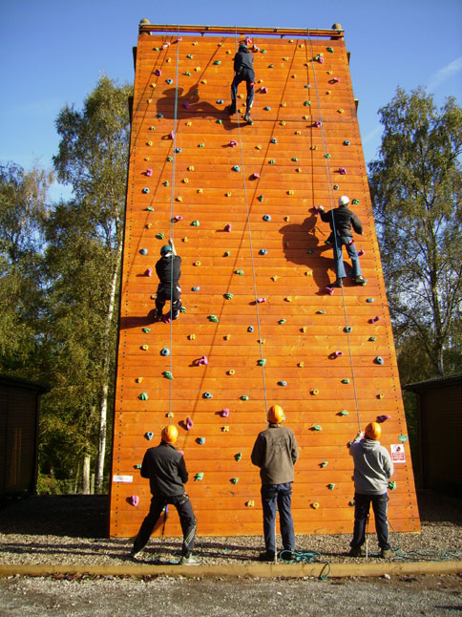
The Challenge of risk taking...
© Di Pardoe Training and Consultancy 2014

Slide 23
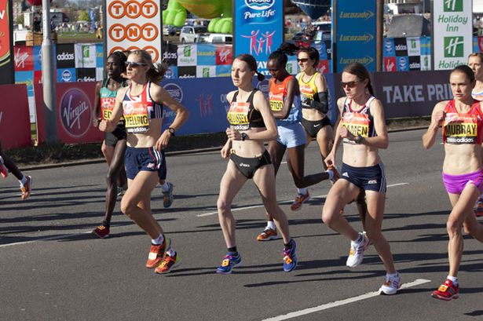
The challenge of persevering and keeping going…
© Di Pardoe Training and Consultancy 2014

Slide 24

What is achievement?
Think of something that you have achieved.....
Now consider how you achieved it.....
© Di Pardoe Training and Consultancy 2014

Slide 25
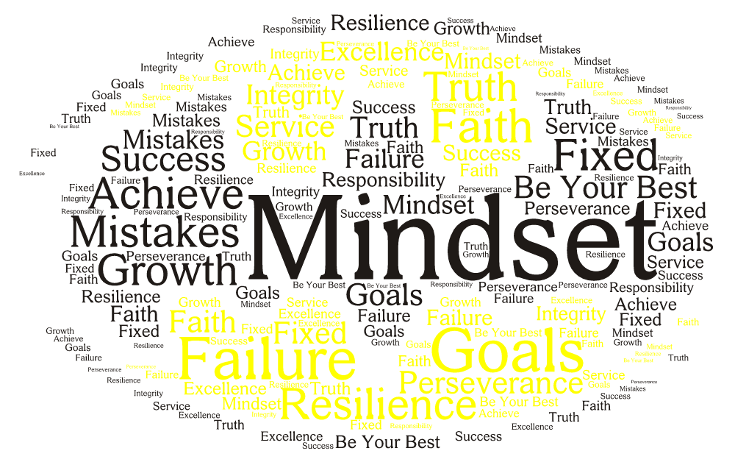

Slide 26
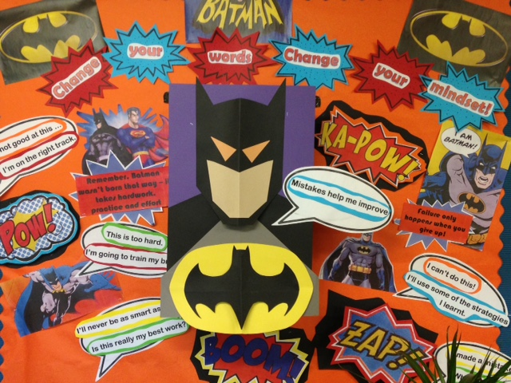
…something that has been done or gained by effort
…the act or process of completing something successfully after working hard
…’overcoming difficulty’
© Di Pardoe Training and Consultancy 2014

Slide 27
“Motivation is the most important factor in determining whether you succeed in the long run. What I mean by motivation is not only the desire to achieve, but also the love of learning, the love of challenge and the ability to thrive on obstacles. These are the greatest gifts we can give our students.”
Carol Dweck 2006
© Di Pardoe Training and Consultancy 2014

Slide 28
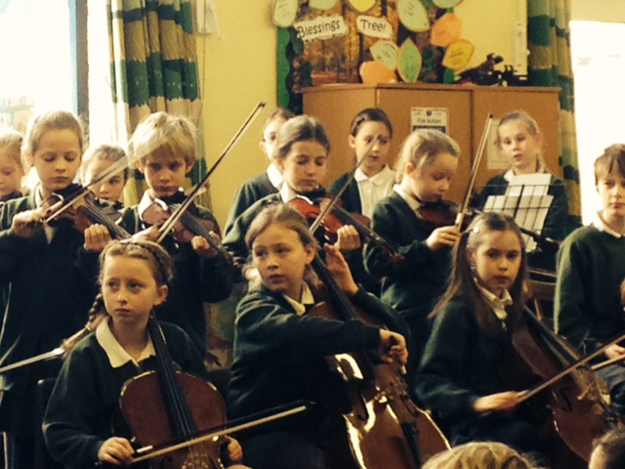
A good learner is someone who....
thinks hard
has a go
shares ideas with others
works with a partner
finds out new things
always tries hard
helps other people
listens carefully
doesn’t distract others
tells the truth
understands what they have to do
doesn’t give up
© Di Pardoe Training and Consultancy 2014

Slide 29


Slide 30
Digital Leaders
What we love about Crowmarsh Primary

Slide 31
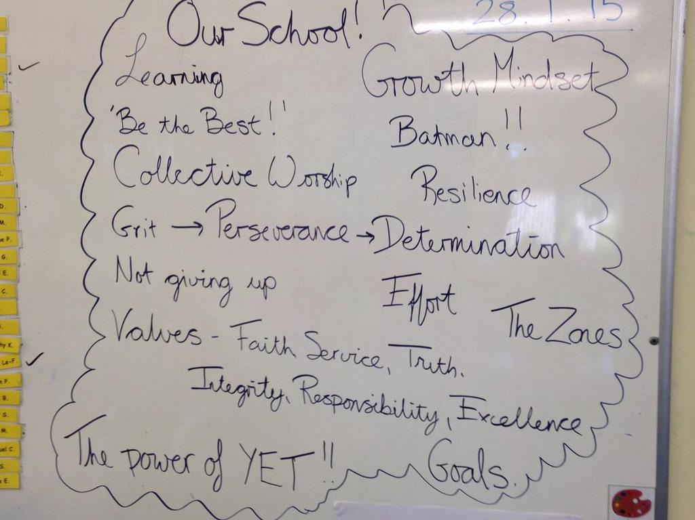
Our creative curriculum designed to create ‘well-rounded’ children….
Assessed Subjects – Reading, Writing, Maths
Science
Computing
Music
German
PSHCE/RE
Geography/History
Art/Design Technology
P.E
After-School Activities
Cooking
Trips – extending the curriculum
Multiculturalism

Slide 32
Key Reading
Towards Successful Learning – Di Pardoe
Think Like a Learner – Di Pardoe
Mindset – Carol Dweck
Outliers – Malcolm Gladwell
Visible Learning and the Science of How we Learn – John Hattie and Gregory Yates
The Learning Powered School – Guy Claxton, et al.
Expansive Education – Bill Lucas, Guy Claxton and Ellen Spencer

Slide 33
IT in School
Current Position – Network, Netbooks, Other Equipment
Vision for the future – renewal of Netbooks and additional resources
Priority 1 - Essential Investment
Priority 2 - Ideal Investment
Further Meeting to be held shortly to focus purely on IT and to galvanise fundraising efforts
Notes:
Considerable investment in the Network over the last two financial years. Resourced with help of PTA additional resources for curriculum

Slide 34
Governor Involvement in School
“Whole school” approach
Governance is strategic, Management is operational
3 main roles:
  Ensuring clarity of vision, ethos and strategic direction
  Holding the Head Teacher to account for the educational performance of the school and its pupils and the performance management of staff
  Overseeing the financial performance of the school and making sure its money is well spent

Slide 35
Governor Involvement Cont:
We do not get or become involved with the day-to-day management of the school,
No micro management of leadership team
Role is driven by the strategic planning cycle in collaboration with all staff members
Do act as ‘critical friend’ to HT and school but have to maintain over-arching view
Everything around “How” is for the HT, everything around “What” is for Governing Body

Slide 36
GB Areas of Responsibility
Teaching & Learning – pupil achievement and quality of teaching for the ‘whole’ school
Finance – approving and monitoring the school budget
Staffing – number, policy on staff pay, appointment, welfare, conduct, grievances, discipline, performance management
Premises
Pupil Behaviour and Discipline
Special Educational Needs
Health & Safety
Safeguarding

Slide 37
Terms of Reference for Finance, Personnel, Premises & H&S
(Flora Barton, Rob Mullan, Penny Hannigan,
Laura Millbourn, Jeremy Goulston)
PERSONNEL AND FINANCE COMMITTEE
Personnel
• To review and update the staffing structure after consultation with the head teacher
• To adopt the pay policy for all categories of staff for approval of the governing body, and to be responsible for the administration and review of these policies
• To oversee the appointment procedure for all staff , to oversee the process leading to staff reductions and the system for staff appraisal
• To make recommendations to the governing body in respect of the annual performance review of the head teacher (by select committee)
• In consultation with the head teacher, to make recommendations to the governing body in respect of the annual performance review of the assistant head teacher and other staff and to monitor staff absence
Finance
• To draft, in consultation with the head teacher and Oxfordshire County Council, the school’s annual budget
• To prepare a budget position statement including virement decisions for each termly meeting of the full governing body
• To monitor the expenditure of all voluntary funds kept on behalf of the governing body
• To ensure that the school operates within the Financial Regulations of the County Council
• To make recommendations to the governing body in respect of service agreements
• To approve arrangements for repairs and maintenance including contracts.
PREMISES AND HEALTH AND SAFETY COMMITTEE
➢ To advise the governing body on priorities, including Health and Safety, for the maintenance and development of the school’s premises.
➢ To keep under review the governing body’s Health and Safety Policy and make recommendations for revisions.
➢ To oversee arrangements for repairs and maintenance.
➢ To oversee arrangements for the use of school premises by outside users subject to governing body policy.

Slide 38
Terms of Reference for Curriculum & Standards (Flora Barton, Michelle Andrews, Karen Murray-Vaughan, Alison Butler, Sarah Lowe, Tony Crabbe)
It is the specific intention of the committee to promote and ensure maintenance of high quality teaching for all children.
Assist the governing body with its understanding of the curriculum, current trends, needs and development within each curriculum area.
Work with the Head teacher and staff to monitor and evaluate curriculum provision and standards of attainment throughout the school.
Work with the Head teacher and staff to raise standards in the school.
This committee supports the governing body in fulfilling its aims by:
Ensuring the school is fulfilling its statutory obligations regarding the Foundation Stage and National Curriculum.
Reviewing the schools strategic plan and SDP. This document details the teaching and learning priority plans
Collaborating with staff to provide information on how the curriculum is taught, evaluated and resources.
Performing curriculum focussed governor visits are required.
Ensuring curriculum policies are relevant and up to date.
Considering the identification assessment and provision given to children with special educational needs.
Reviewing available information about the schools performance including county and national benchmark information.
Contributing to the School Development Plan
Working with the School Management team, to advise the governing body of the school improvements and achievements within the targets that have been set by the school.

Slide 39
Reconstitution
Government Regulation that all GBs reconstitute
Review of numbers, designations and effectiveness
Lost 4 Governors since July last year who collectively have served circa 30 years in office but who have yr 6 children, not unexpected
Need to recruit more Governors once Reconstitution approved (September 2015)– focus on skill sets to contribute to effective governance
Please consider it! A vital role that is rewarding
Notes:
Parents with skills, contacts, knowledge – need to use these attributes.

Slide 40
Curriculum Co-ordinators
Area / Subject | Staff Co-ordinator | Governor
Maths | Karen Murray-Vaughan / Annette Marsh | Tony Crabbe
English | Andy Silvester / Katie Lucas | Nigel Hannigan
Science | Andy Silvester / Katie Lucas | Rob Mullan
R.E. | Peta Hustwayte | Jeremy Goulston
ICT | Karen Corrigan / Corinna Bailie | Nigel Hannigan & Laura Millbourn
Geography | Monica Nixon / Alison Butler | vacancy
History | Monica Nixon / Alison Butler | vacancy
Art & DT | Monica Nixon / Karin Selwood | vacancy
Music | Zara Zimmerman | vacancy
PE | Flora Barton & Corinna Bailie | Michelle Andrews
Early Years | Zara Zimmerman | Sarah Lowe
Special Needs | Flora Barton / Karen Murray-Vaughan | vacancy
PSHCE |  | Laura Millbourn
More Able (G&T) | Karen Murray-Vaughan | Michelle Andrews
Assessment | Flora Barton | Michelle Andrews
Other Areas | Flora Barton / Karen Murray-Vaughan | Various

