Slide 1

Welcome
Agenda:
Review of Last 12 Months – Safeguarding
Overview of School Development
Assessment/Feedback ‘Life without Levels’
Academies
Open Q&A
~Working in Partnership for Success~
Faith ◊ Service ◊ Integrity ◊ Responsibility ◊ Truth ◊ Excellence

Slide 2
The Past Year at Crowmarsh
What we Have Achieved…
~Working in Partnership for Success~
Faith ◊ Service ◊ Integrity ◊ Responsibility ◊ Truth ◊ Excellence

Slide 3
Achievements and Progress……
Listed in the top 200 primary schools in The Times
Received SSAT award putting us in top 20% of schools for attainment (April 2016)
New playground equipment thanks to Lottery Funding and parent’s working party
ASPIRE Writing
Dynamic teaching team
Children who demonstrate school values and seek knowledge…
~Working in Partnership for Success~
Faith ◊ Service ◊ Integrity ◊ Responsibility ◊ Truth ◊ Excellence

Slide 4
Safeguarding Updates
Safeguarding priority
Rigorous safeguarding induction for volunteers
E-Safety – external and internal expertise
Mobile phone policy
Playtimes – supervision over and above
As a result of parent survey regarding communication – looking into setting up meeting system
~Working in Partnership for Success~
Faith ◊ Service ◊ Integrity ◊ Responsibility ◊ Truth ◊ Excellence

Slide 5
External Changes….
In the news – balance change – doing what is right for our pupils
Removal of Levels
New curriculum – more challenging
New SATS tests and grading system
~Working in Partnership for Success~
Faith ◊ Service ◊ Integrity ◊ Responsibility ◊ Truth ◊ Excellence

Slide 6
Teaching Children How to Learn…..
Purple Learners
Training children to independently choose challenge
Trios across school
Mastery- children teaching others
Working to close all gaps
Using Higher Order Questioning
Celebrating mistakes
Research informing practice
Embedding ‘learning traits’ – Learning Detectives
~Working in Partnership for Success~
Faith ◊ Service ◊ Integrity ◊ Responsibility ◊ Truth ◊ Excellence

Slide 7
Find out more…..
Purple Learning Week – way to share what we do with parents and the community
Website – book list and key school documents and policies.

Slide 8
Our children at the end of primary…..
At your tables discuss…..what traits and qualities do you want your child(ren) to have when they leave year 6?
Please write them down on the post-its and stick them on the sheets at your tables.
~Working in Partnership for Success~
Faith ◊ Service ◊ Integrity ◊ Responsibility ◊ Truth ◊ Excellence

Slide 9


Slide 10



School Development
A strategic, forward looking, whole school plan
Input from all stakeholders
Focus is on continual ‘improvement’
Outlines: action, success criteria
& impact

Slide 11
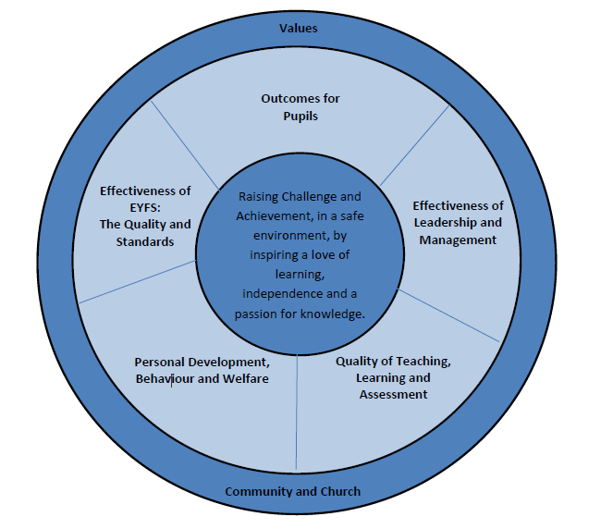
School Development Plan

Slide 12

Effectiveness Of Leadership & Management
Empowering and driving Leadership throughout our school
  Effective distribution
  Enhanced networking
  Sharing Best Practice
  Strategic thinking
  Challenge status quo

Slide 13

Effectiveness of Early Years Provision
Support children in beginning journey to becoming life long learners
  Use their voice
  Child centred
  Become independent
Smooth Transition
Create the ‘environment’

Slide 14

Quality of teaching, learning & assessment
Always being ‘the best we can be’
Inspirational teaching
Inspiring curriculum
Effective assessment
Developing a ‘Growth Mindset’
culture

Slide 15
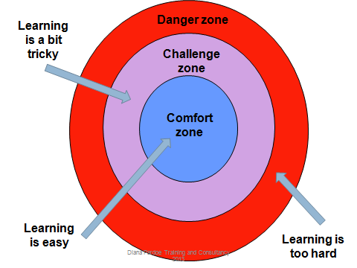
Outcomes for Pupils
Progress, progress, progress
Challenge for all
Embed the pupil voice
Prepare ‘for life’

Slide 16

Personal development, behaviour & welfare
Safeguarding is paramount
Pupil Voice to raise achievement & aspirations
International School links
Model our values

Slide 17
School Development Plan

Slide 18
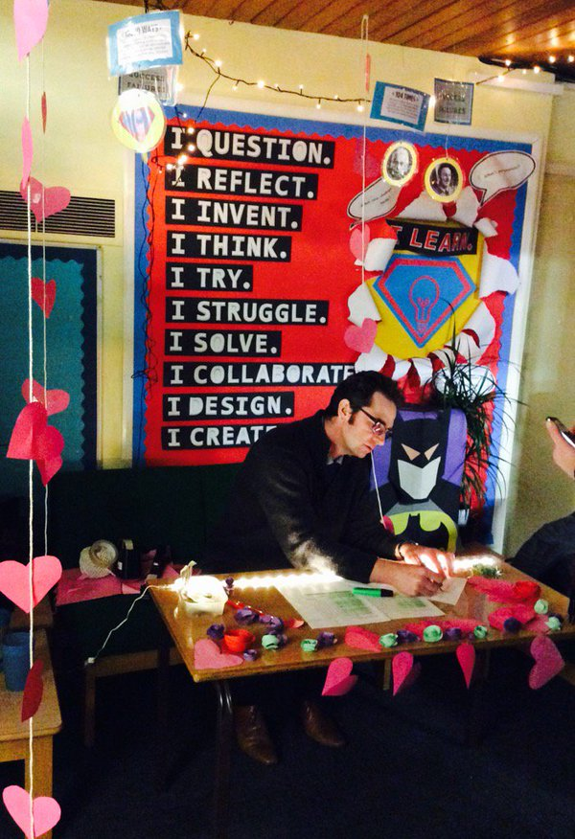
Mr Silvester – Life Without Levels

Slide 19
The rationale for the removal of levels….
‘Best fit’ - pupil could have serious gaps in their knowledge and understanding, but still be placed within the level.
Levels did not lend themselves to assessing the underpinning knowledge and understanding of a concept. For example, using certain vocabulary in written work was indicative of a level, but did not necessarily provide evidence of conceptual understanding
~Working in Partnership for Success~
Faith ◊ Service ◊ Integrity ◊ Responsibility ◊ Truth ◊ Excellence

Slide 20
The rationale for the removal of levels….
Progress became synonymous with moving on to the next level, but progress can involve developing deeper or wider understanding, not just moving on to work of greater difficulty. Sometimes progress is simply about consolidation.
Pupils compared themselves to others and often labelled themselves according to the level they were at leading to a fixed mind-set (particularly damaging where pupils saw themselves at a lower level).
~Working in Partnership for Success~
Faith ◊ Service ◊ Integrity ◊ Responsibility ◊ Truth ◊ Excellence

Slide 21
The benefits of assessment without levels
Without levels, schools can use their own assessment systems to support more informative and productive conversations with pupils and parents. They can ensure their approaches to assessment enable pupils to take more responsibility for their achievements by encouraging pupils to reflect on their own progress, understand what their strengths are and identify what they need to do to improve. Focusing assessment on the content of the school’s curriculum will allow for communications with parents and carers to provide a clearer sense of how to support their children to build and consolidate learning.
~Working in Partnership for Success~
Faith ◊ Service ◊ Integrity ◊ Responsibility ◊ Truth ◊ Excellence

Slide 22
Why Do We Assess?
to allow teachers to plan work that accurately reflects the needs of each child
to help our children understand what they need to do next to improve their work
to provide regular information for families that enables them to support their child’s learning
to contribute towards accountability data
~Working in Partnership for Success~
Faith ◊ Service ◊ Integrity ◊ Responsibility ◊ Truth ◊ Excellence

Slide 23
Purple Learners

Slide 24
Why Has Work Been Marked?
who is it for?
can the child access the feedback given?
how does it promote learning?
has it been effective?
~Working in Partnership for Success~
Faith ◊ Service ◊ Integrity ◊ Responsibility ◊ Truth ◊ Excellence

Slide 25
Academies Update…
Government Directive is to have all schools convert to Academies status or have plans to do so by 2022 as announced in the budget ‘Big Push’
Plans to compel high performing schools to convert will be abandoned (as of today)
Mixed media coverage as a result and mixed results for those that have already converted
61/26 % of Oxfordshire Primary Schools have already converted (about national average)
~Working in Partnership for Success~
Faith ◊ Service ◊ Integrity ◊ Responsibility ◊ Truth ◊ Excellence

Slide 26
Academies Update….
9 of these have been ‘sponsored’ i.e. were forced to convert due to the school being in Special Measures.
Multi-Academy Trusts, Collaborative Companies, Umbrella Trusts. Recommended size is circa 2000 pupils.
Church School – do not have to go with Diocesan Trust but would need to approve our proposal.
No further windfall payments
LM/FB have attended meetings by OCC/Diocese – also attending further meetings with large group of mostly local schools and external consultant.
~Working in Partnership for Success~
Faith ◊ Service ◊ Integrity ◊ Responsibility ◊ Truth ◊ Excellence
Notes:
Group

