Slide 1
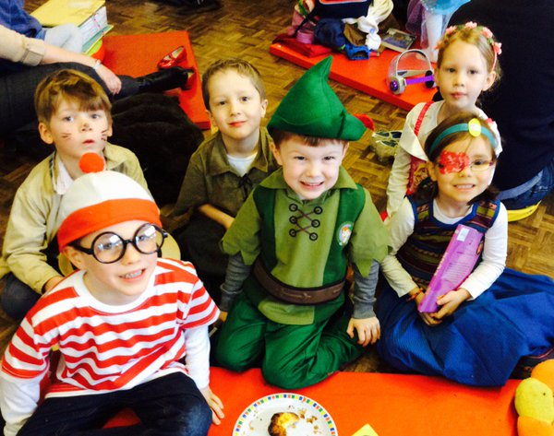
This is Our School…
Crowmarsh Gifford Church of England Primary School
A Snapshot of 2015-2016

Slide 2
“No matter what your ability is, effort is what ignites that ability and turns it into accomplishment.”
~Carol Dweck~

Slide 3
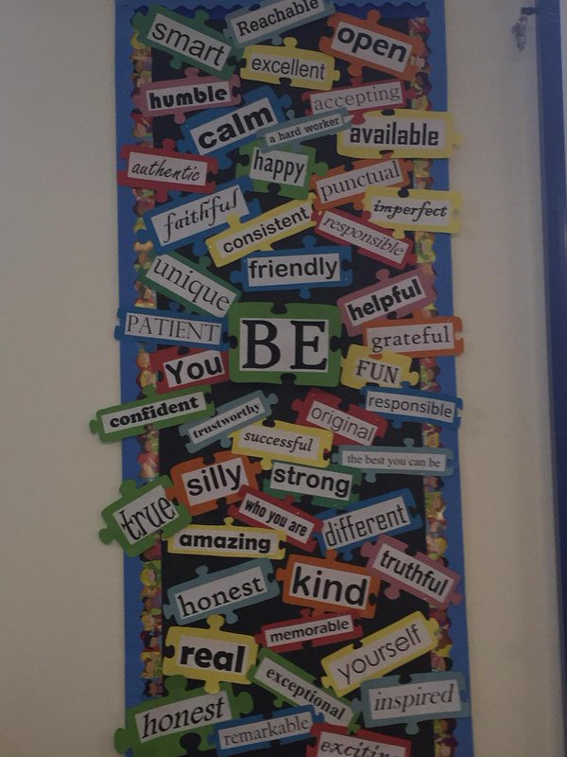
BE…
Brave
Fortitudinous
Extraordinary
Focused
A Leader
Aware

Slide 4
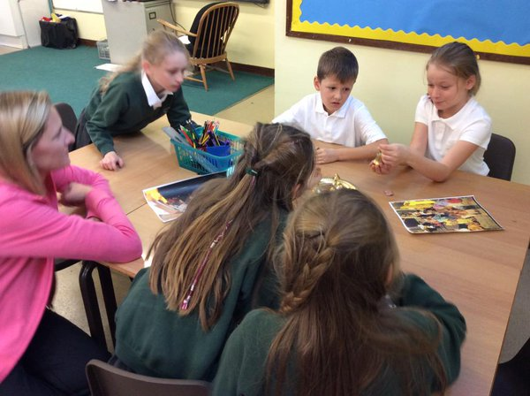
Debate, Discuss, Question…

Slide 5
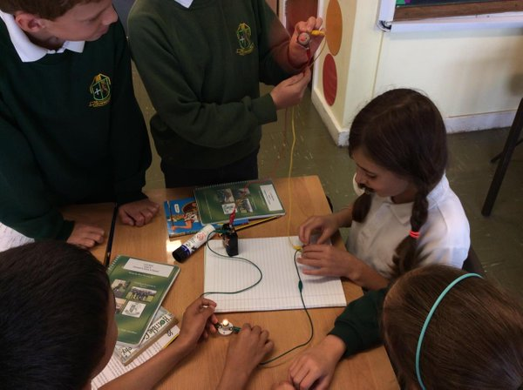

Slide 6
“Red lights will stop you in your tracks, you look outside your window and see all the shards of glass and thorns, but you step out and walk the hard way to victory…”
~Amber Year 4~

Slide 7
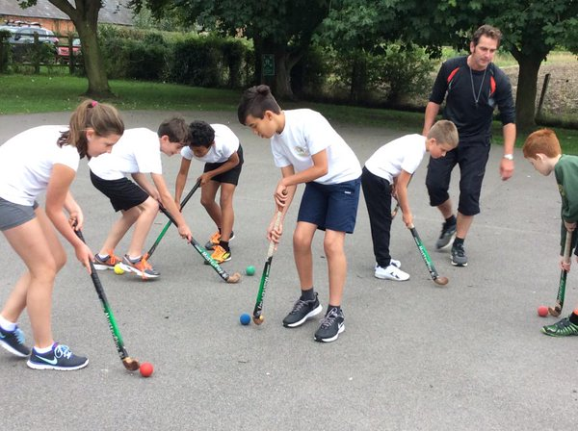
Sports and Games…

Slide 8
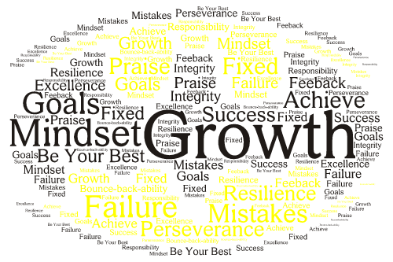
I Question.
I Reflect.
I Invent.
I Think.
I Try.
I Struggle.
I Solve.
I Collaborate.
I Design.
I Create. I LEARN!!

Slide 9
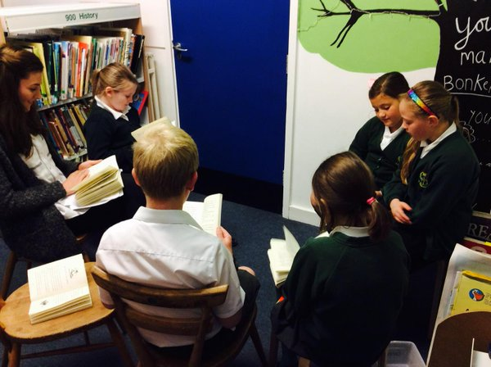
We love reading…..

Slide 10
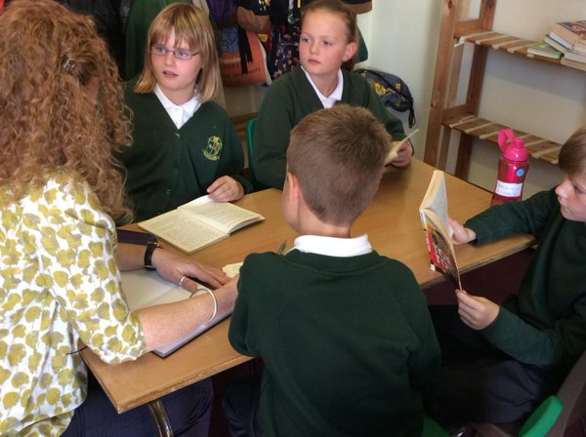

Slide 11
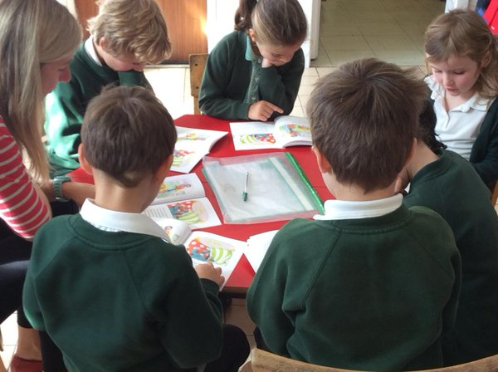

Slide 12
“My favourite thing is learning. I NEVER give up!”
~Sophie Year R~

Slide 13
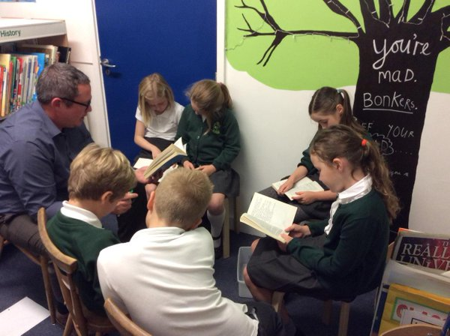

Slide 14
All of our teachers always help us learn. Our school encourages us to learn from our mistakes!
~Year 3~

Slide 15
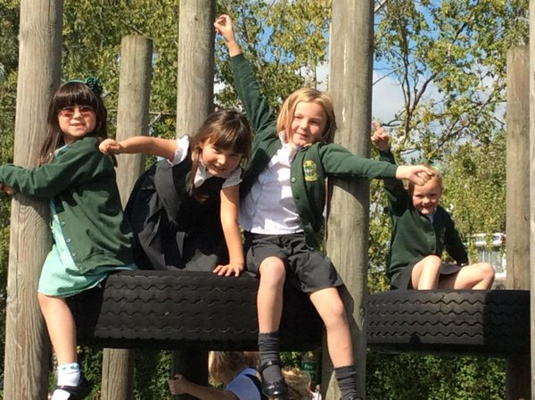

Slide 16
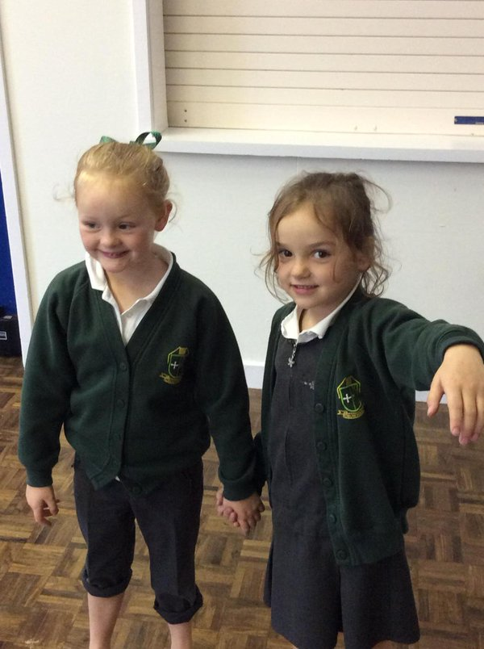
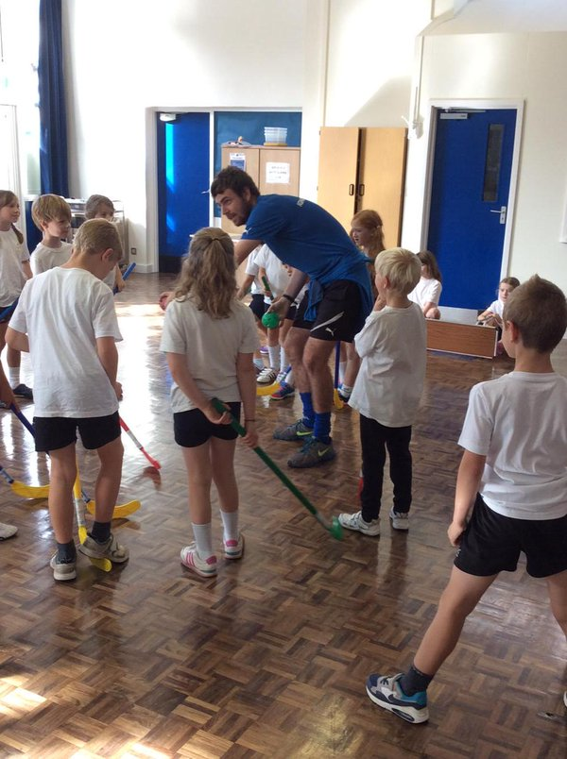
PE with Mr Shorter…

Slide 17
Our Collective Worships are good because we talk about perseverance, resilience, grit and all that – tis is what makes us a very good school.
~Oliver Year 2~

Slide 18
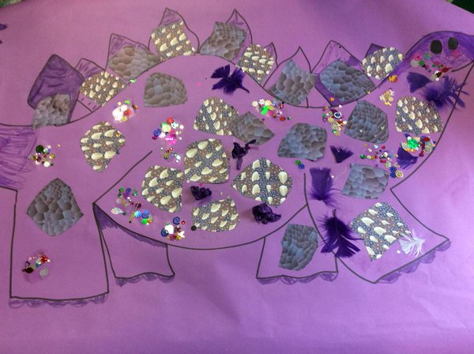
Purple Learners Everywhere!

Slide 19
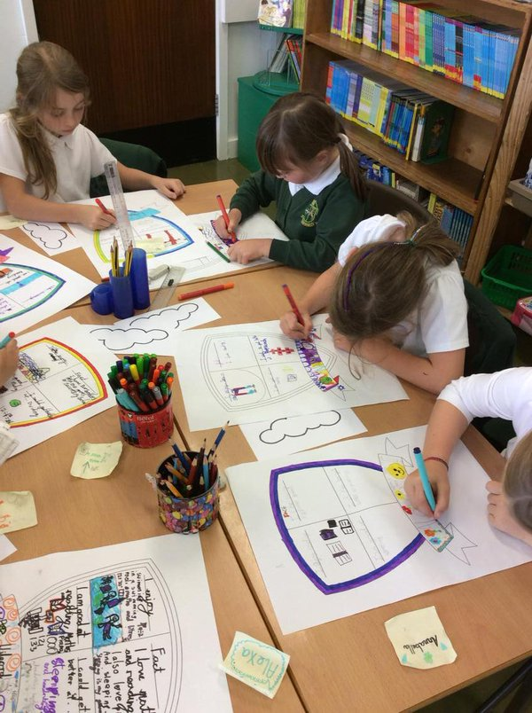
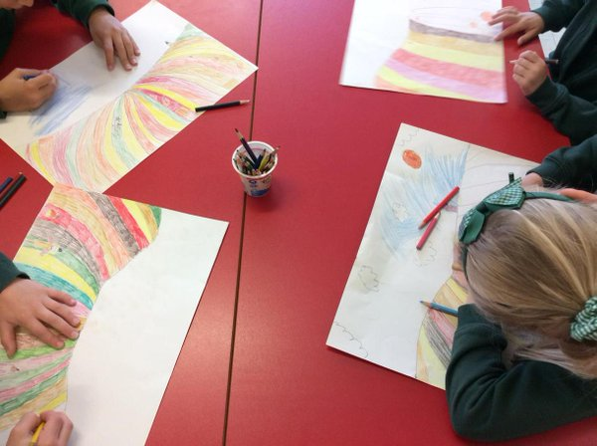
Art, Design &Technology

Slide 20
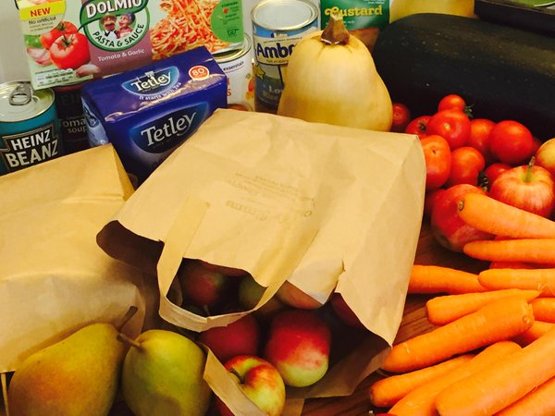

Service

Slide 21
“If we ever try to give up, our tachers tell us that we have to keep going – they just say, “you can’t do it YET!”
~Year 3~

Slide 22
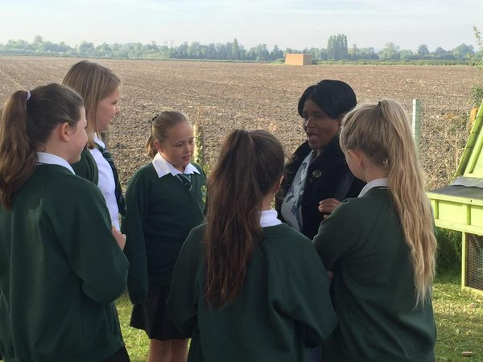
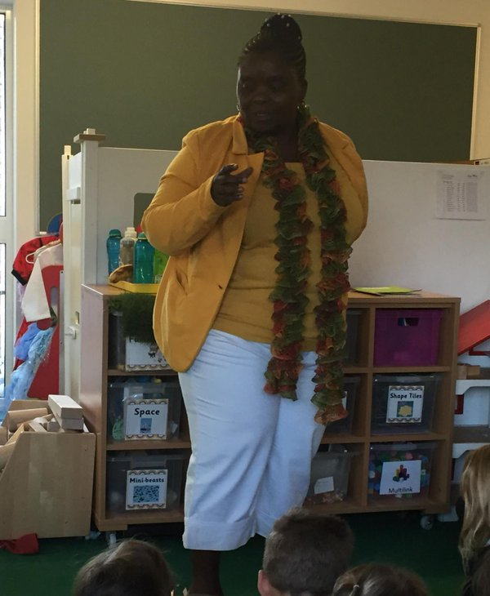
International Schools

Slide 23
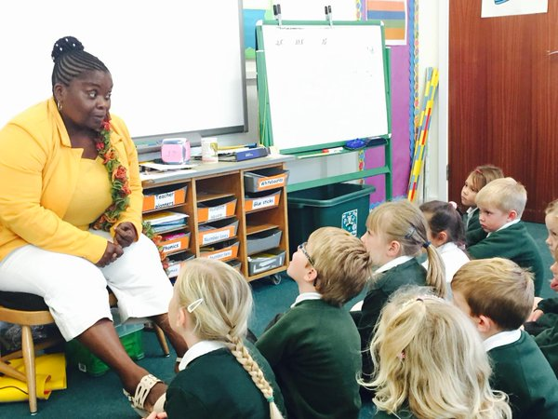
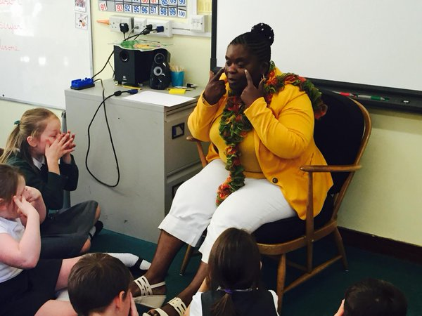
Sharing best practice- overseas

Slide 24
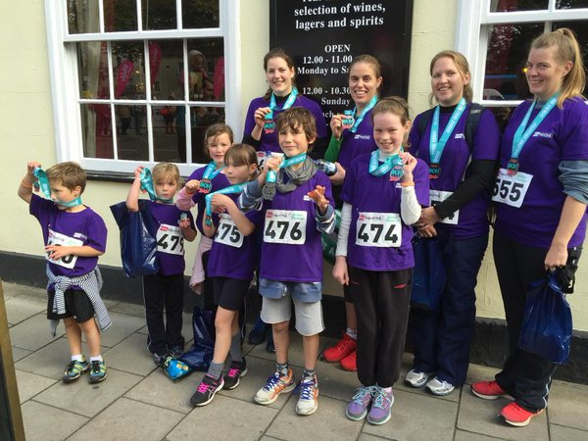
Everyone taking a challenge…

Slide 25
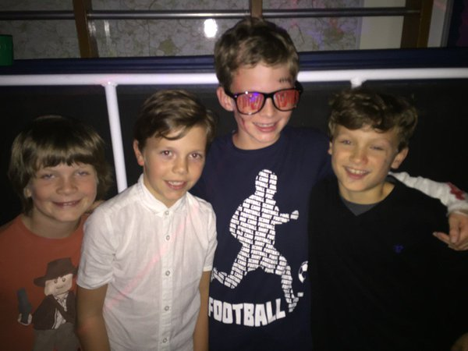
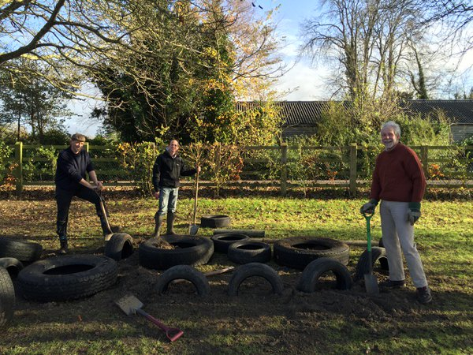
Amazing PTA
Events
Volunteering

Slide 26
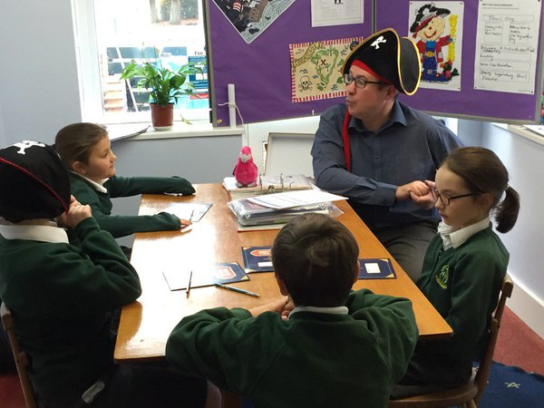

Slide 27
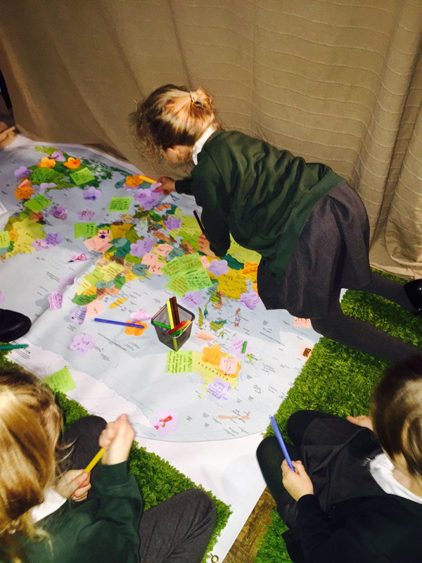
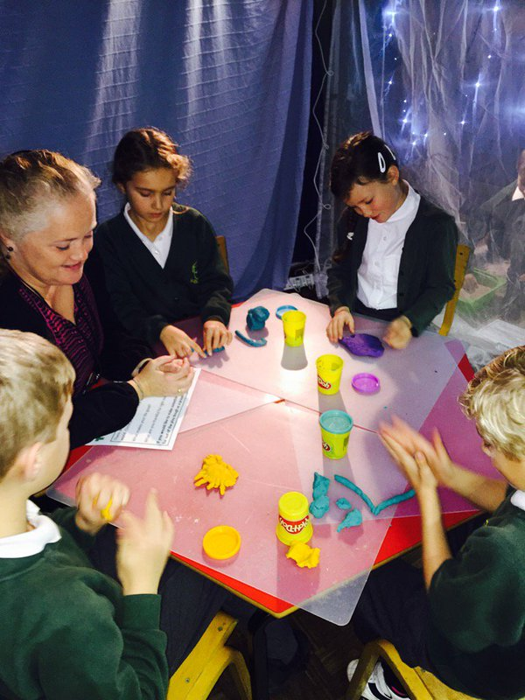

Slide 28
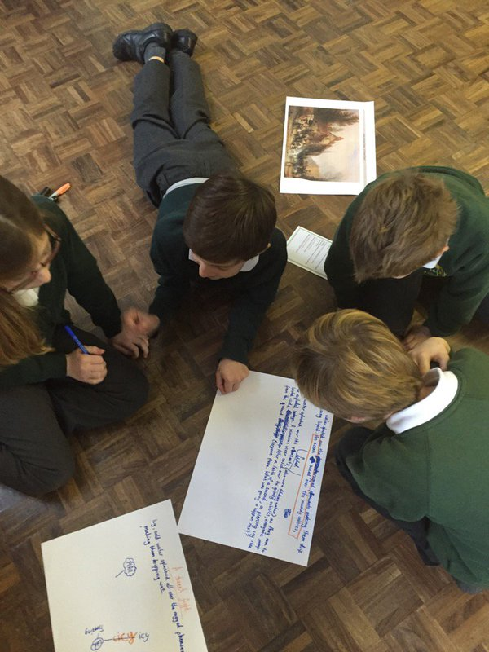
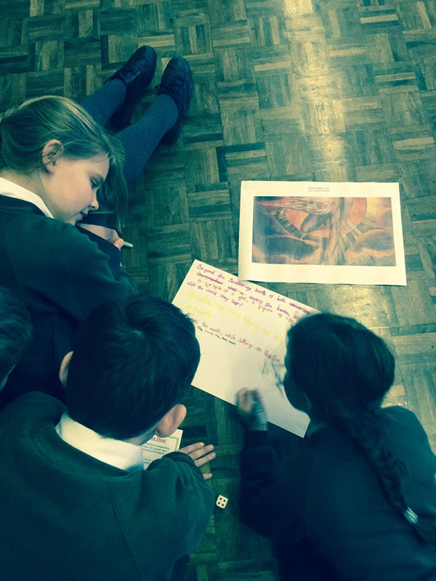

Slide 29
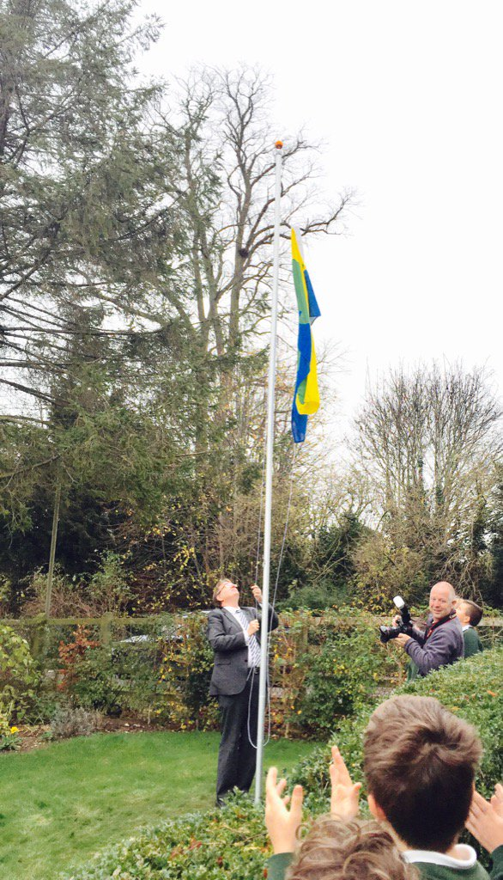
Learning about British Values
Parliament Flags with John Howell

Slide 30
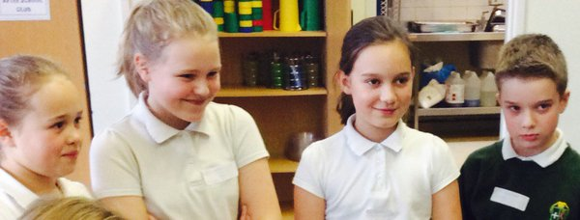
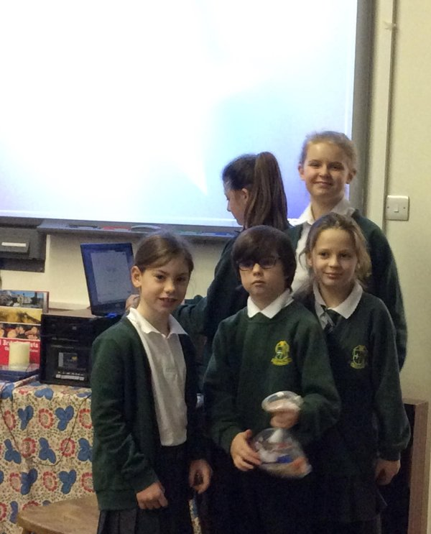
School Leadership

Slide 31
“This school has leaders, not followers.”
~Harley Year 6~

Slide 32
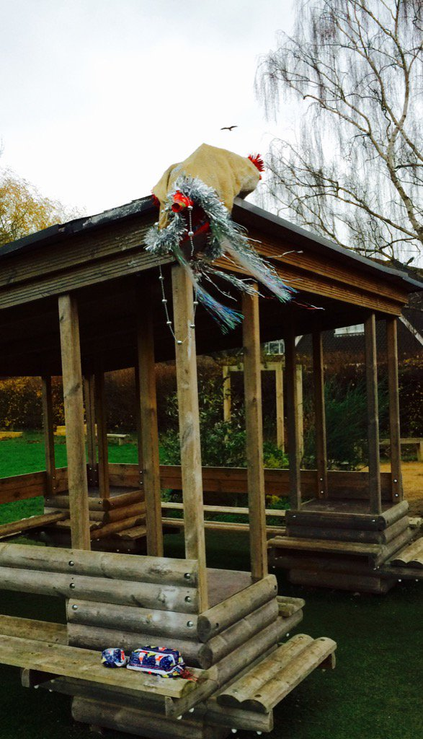
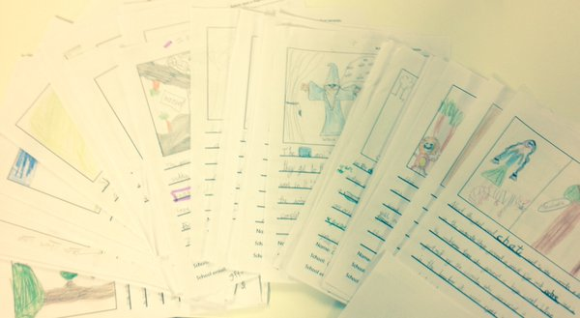
Inspiring Writing…

Slide 33
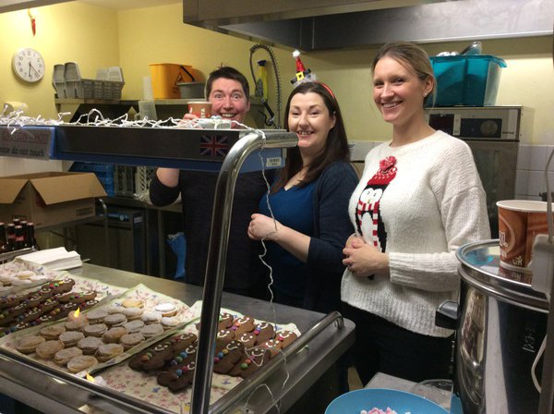
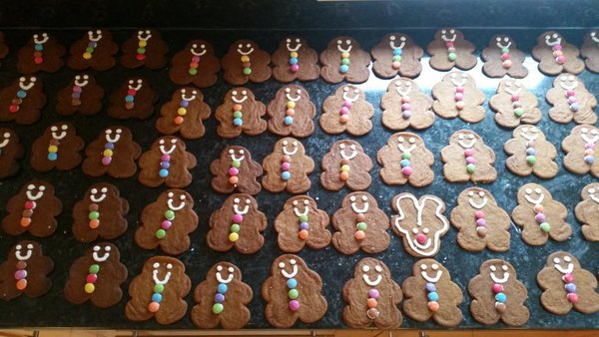
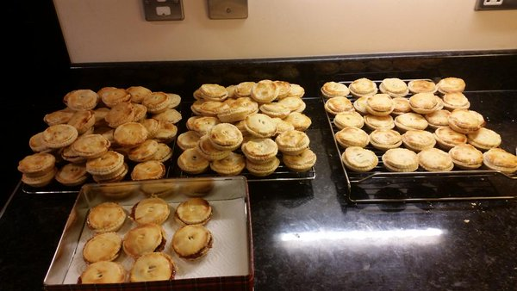
Dedicated Parents!

Slide 34
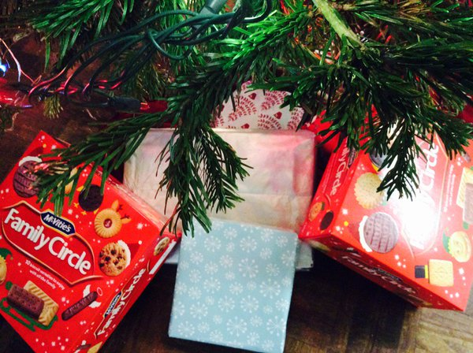
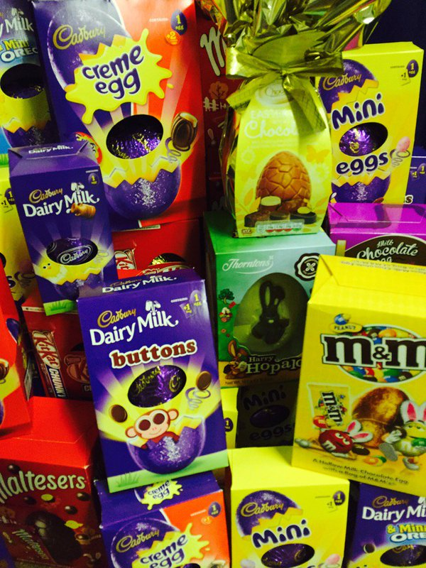
Service…
Reaching out to our community

Slide 35
“Learning can sometimes be hard but I never, never, ever give up and I keep on going.”
~Olivia Year R

Slide 36
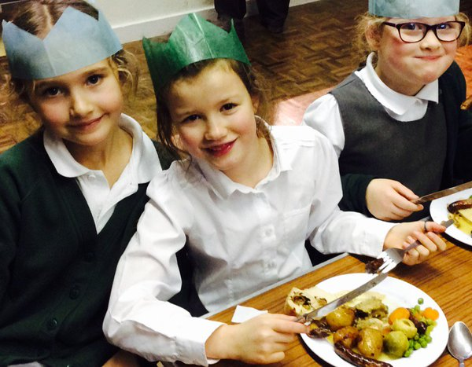
We are a family….close knit community.

Slide 37
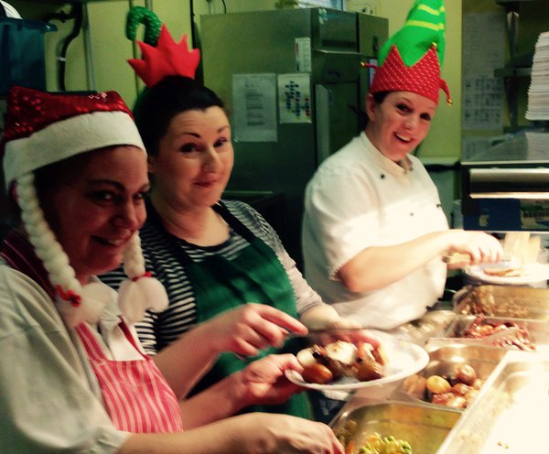
Fantastic Team…

Slide 38
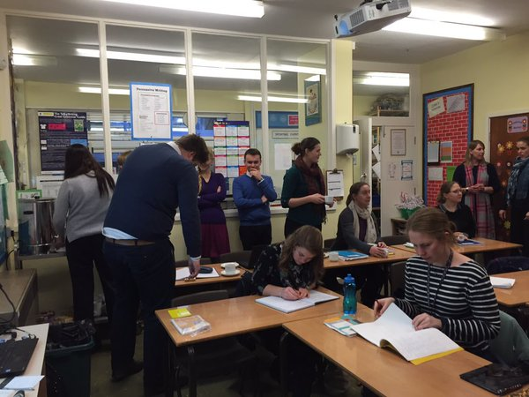
Partnership Working – Sharing Best Practice….ALWAYS

Slide 39
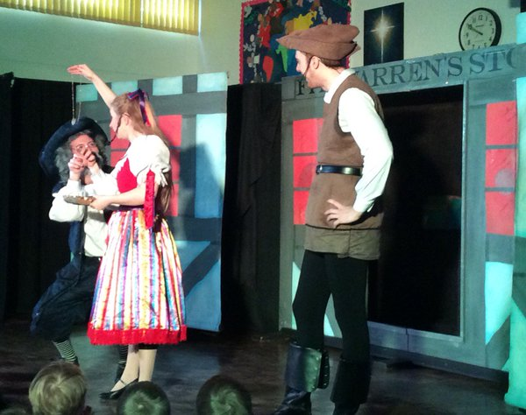
Drama, Workshops...engaging learning…

Slide 40
“The teachers make sure the lessons are always fun and enjoyable.”
~Year 4~

Slide 41
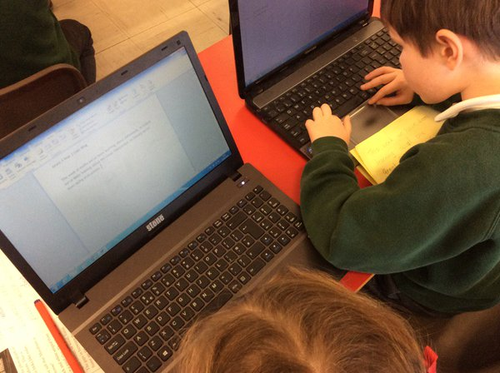
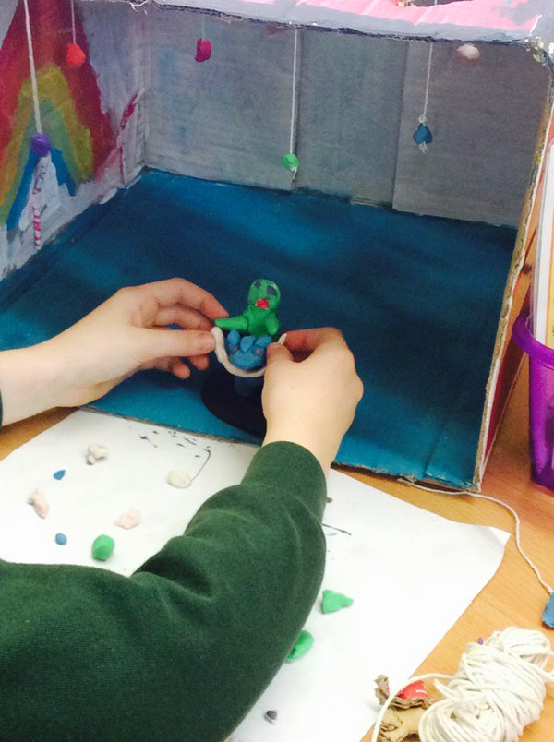
Using ICT to create, design and imagine…

Slide 42
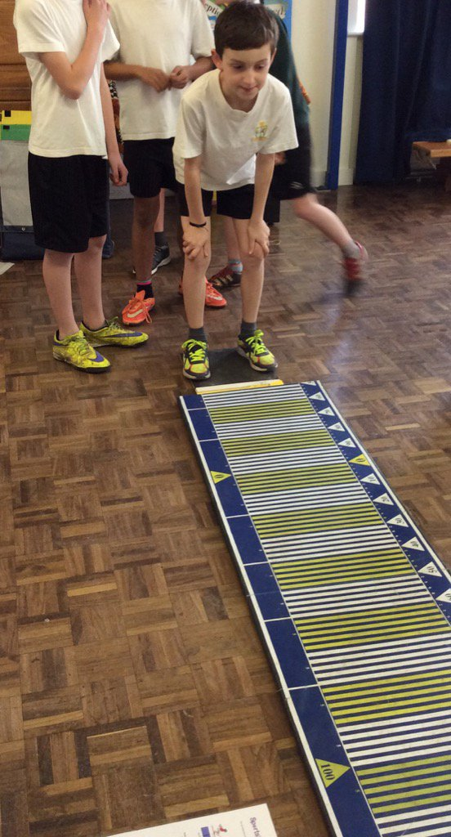
Always striving to push ourselves that much further…

Slide 43
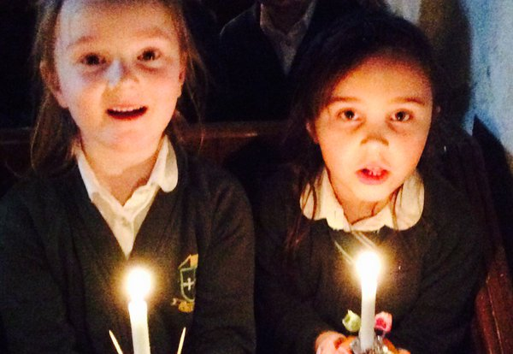
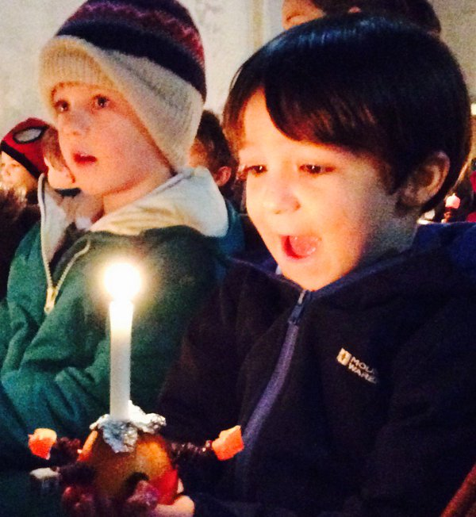
School Values and Traditions…

Slide 44
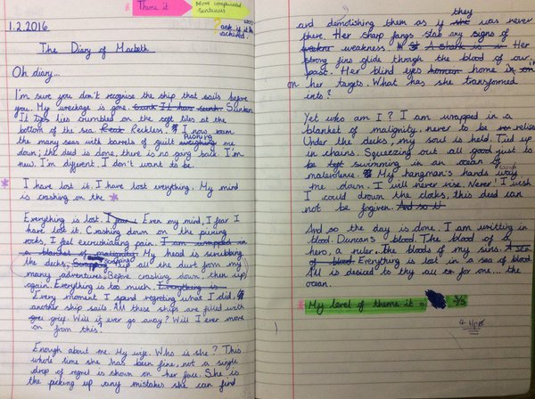
Always looking to improve….

Slide 45
“This school forms pupils who make the impossible, possible.”
~Oscar – Year 6~

Slide 46
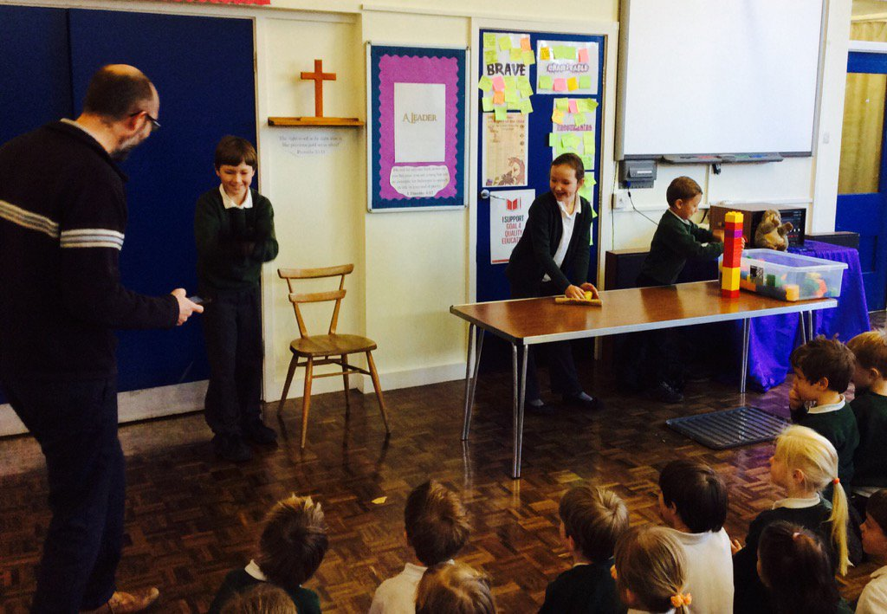

Visitors and New Perspectives…

Slide 47


Love our Reading Mornings!

Slide 48
“The teachers are really good because they push you to challenge yourself.”
~Year 5~

Slide 49


Parents in School – Breakfast and Crafts!

Slide 50


House Challenges…

Slide 51

Learning about the world around us…

Slide 52

Dance and county-wide sporting events…

Slide 53

Hands on Learning…

Slide 54

Always learning how to keep ourselves safe…

Slide 55
Whether you think you can or you think you can’t….you are right.
~Henry Ford~

